Slide 1
HEART DISEASE PREDICTION
TSP- AI ML Fundamentals (Capstone Project)
Presented By:
S.Jeswin– au810021114034
Guided By:
Ramar Bose Sr.AI Master Trainer

Slide 2
OUTLINE
Problem Statement (Should not include solution)
Proposed System/Solution
Algorithm & Deployment
GitHub Link
Project Demo(photos / videos)
Conclusion
Future Scope
References

Slide 3
Problem Statement
You are tasked to perform Heart Disease Prediction Using Logistic Regression. The World Health Organization has estimated that four out of five cardiovascular disease (CVD) deaths are due to heart attacks. This whole research intends to pinpoint the ratio of patients who have a good chance of being affected by CVD and predict the overall risk using Logistic Regression.

Slide 4
Proposed Solution
The proposed system, the analysis of the cardiac disease UCI dataset is carried out using suitable data acquisition, preprocessing by cleaning the data, then using selects all the features which have high correlation with the target function. Then logistics regression model was trained and tested for predicting the cardiac disease is present or not. The Fig shows the workflow to build logistic regression cardiac disease classification model.

Slide 5
Algorithm & Deployment
Algorithm for heart disease prediction involves several steps, including data collection, preprocessing, model selection and training, evaluation, and deployment.
Once you have a satisfactory model, deploy it for real-world use. This could involve integrating it into a web application, mobile app, or healthcare system. Ensure that the deployment environment meets privacy and regulatory requirements, especially when handling sensitive medical data.

Slide 6
GitHub Link
https://github.com/au810021114034-Jeswin/au810021114034-Jeswin.git

Slide 7
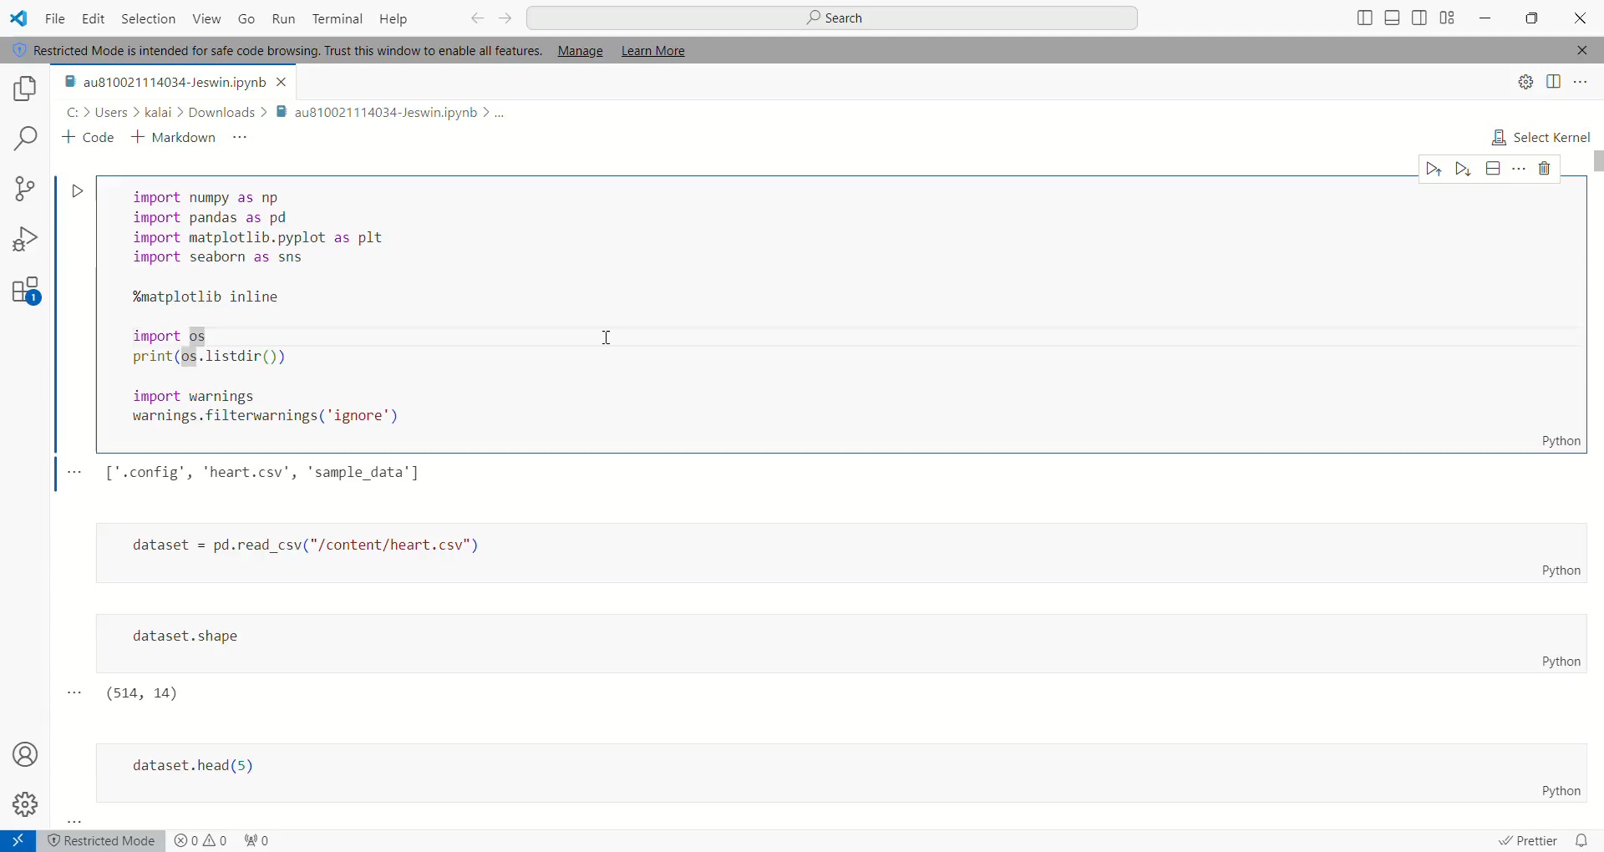
Project Demo(Recorded Video)

Slide 8
Conclusion
One of the important areas in industry of medical is prediction of cardiovascular disease, with the available data of the patient to predict the absence and presence of cardia disease. There are several techniques and methods are present for prediction of cardiovascular disease. In this research, Logistic Regression supervised ML algorithm are used to classify the heart disease. To improve the performance, pre-processing of corpus like Cleaning, finding the missing values are done. The vital part is feature selection, which increase the accuracy of algorithm and even focus on the behavior of the algorithm

Slide 9
Future Scope
The dataset size can be increased and then deep learning with various other optimizations can be used and more promising results can be achieved. Machine learning and various other optimization techniques can also be used so that the evaluation results can again be increased. More different ways of normalizing the data can be used and the results can be compared And more ways could be found where we could integrated heart disease-trained ML and DL models with certain multimedia for the ease of patients and doctors.

Slide 10
References
1. Project Github link, Ramar Bose , 2024
2. Project video recorded link (youtube/github), Ramar Bose , 2024
3. Project PPT & Report github link, Ramar Bose , 2024

Slide 11
THANK YOU

